Slide 1

Docker training
Steven Hermans

Slide 2
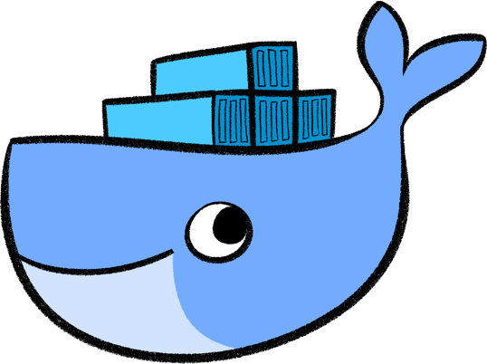
Agenda
Introduction Docker
Build images
Ship images
Run images

Slide 3
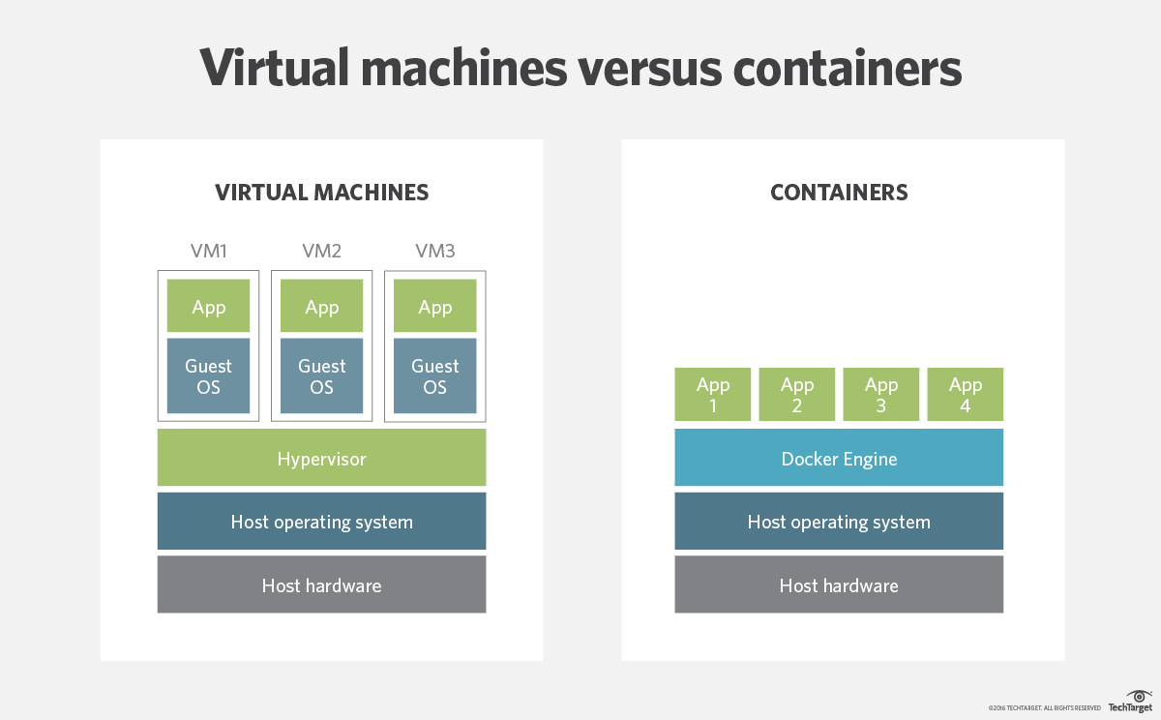
What is Docker

Slide 4
The Docker platform
Docker Engine/Daemon
Docker Hub/Store
Docker Compose
Docker Swarm
Docker for Windows/Mac/AWS/Azure/…

Slide 5
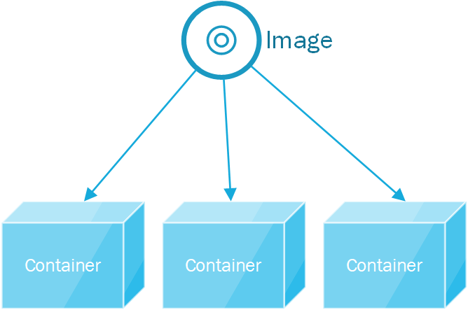
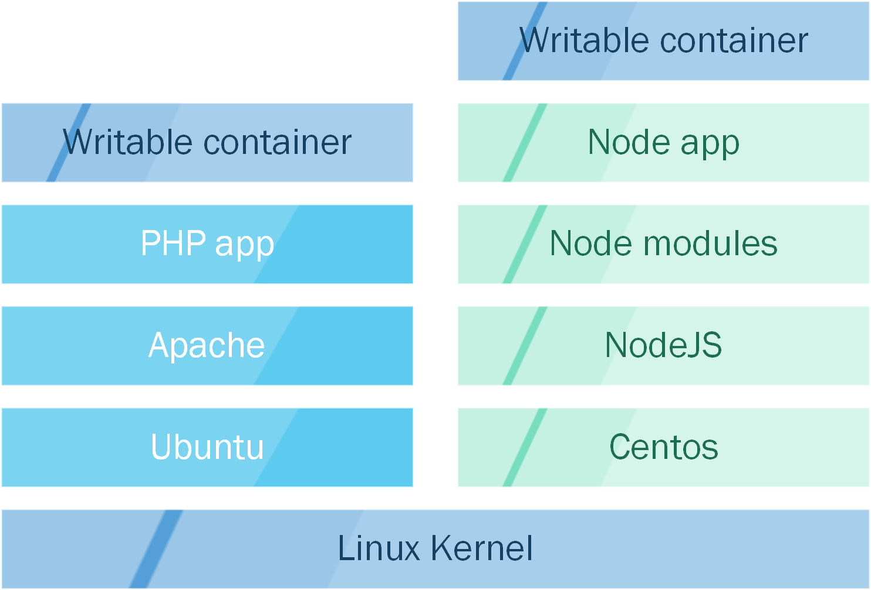
Containers en Images
One image to create multiple containers
Union filesystem

Slide 6
Build, Ship, Run
Demo

Slide 7
> npm install –g express-generator > express docker-demo > mv bin public routes views app.js > src > Dockerfile:
FROM node:6 WORKDIR /app EXPOSE 3000
ADD package.json ./ RUN npm install
ADD . . CMD node ./src/bin/www
> docker build –t docker-demo . > docker run –p 3000:3000 -–name=docker-demo docker-demo > docker stop docker-demo > docker start docker-demo > docker rm –f docker-demo > docker tag docker-demo steven166/docker-demo:1.0 > docker login > docker push steven166/docker-demo:1.0

Slide 8
> docker-compose.yml version: '3‘ services: docker-demo: build: context: . dockerfile: Dockerfile container_name: docker-demo command: node --debug=5858 src/bin/www ports: - 3000:3000 - 5858:5858 volumes: - './src:/app/src'
> docker-compose up –build > launch.json { "type": "node", "request": "attach", "name": "Attach", "port": 5858, "restart": true, "sourceMaps": false, "outFiles": [], "localRoot": "${workspaceRoot}", "remoteRoot": "/app" }

Slide 9
01> docker swarm init –-advertise-addr 192.168.99.100 02> docker swarm join –-token *** 192.168.99.100:2377 01> docker-compose.yml version: ‘3’ services: docker-demo: image: steven166/docker-demo:1.0 ports: - 3000:3000 deploy: mode: replicated replicas: 5 01> docker stack depoy –-docker-compose docker-compose.yml demo-stack 01> docker ps 02> docker ps 01> docker stack services demo-stack 01> docker stack rm docmo-stack

